Slide 1

Project Title -SEASONAL AGRICULTURE PERFORMANCE ANALYSIS
Student Name: Dange Shraddha Ramesh
College Name-Sanjivani College Of Enginnering , Kopargaon
AICTE STU ID : STU698f173426ce21770985268

Slide 2

PROBLEM STATEMENT
(Agricultural activities are influenced by seasonal variations in environmental conditions, farming practices, resource availability and market conditions. As a result, agricultural performance may differ from one season to another. However, raw agricultural data does not clearly explain how agricultural performance changes across seasons or what patterns can be observed in different seasonal conditions. The problem is to analyze the given agricultural dataset and investigate seasonal differences in agricultural performance by identifying meaningful patterns, trends, relationships and variations within the available data.

Slide 3
Project Description Seasonal Agriculture Performance Analysis : This project focuses on analyzing agricultural data collected across different seasons, geographical areas and farming conditions. The dataset includes information related to: 1.Crop and farm details 2.Rainfall and environmental conditions 3. Temperature and humidity 4.Water usage and irrigation methods 5.Soil and fertilizer information 6. Crop yield and production 7.Revenue, cost and profit Project Approach : Data Collection → Data Cleaning → Data Analysis → Seasonal Comparison → Visualization → Insights & Recommendations

Slide 4

WHO ARE THE END USERS?
1.Farmers
To understand seasonal crop performance and resource requirements.
2. Agricultural Planners
To support better seasonal agricultural planning.
3.Researchers and Data Analysts
To study relationships between environmental conditions and agricultural performance.
4. Government and Agricultural Organizations
To support evidence-based agricultural planning and decision-making.

Slide 5

Technology Used
Programming Language : Python
Libraries Used : Pandas , NumPy , Matplotlib , Seaborn
Platform : Google Colab / Jupyter Notebook
Dataset Format : Dataset Format

Slide 6
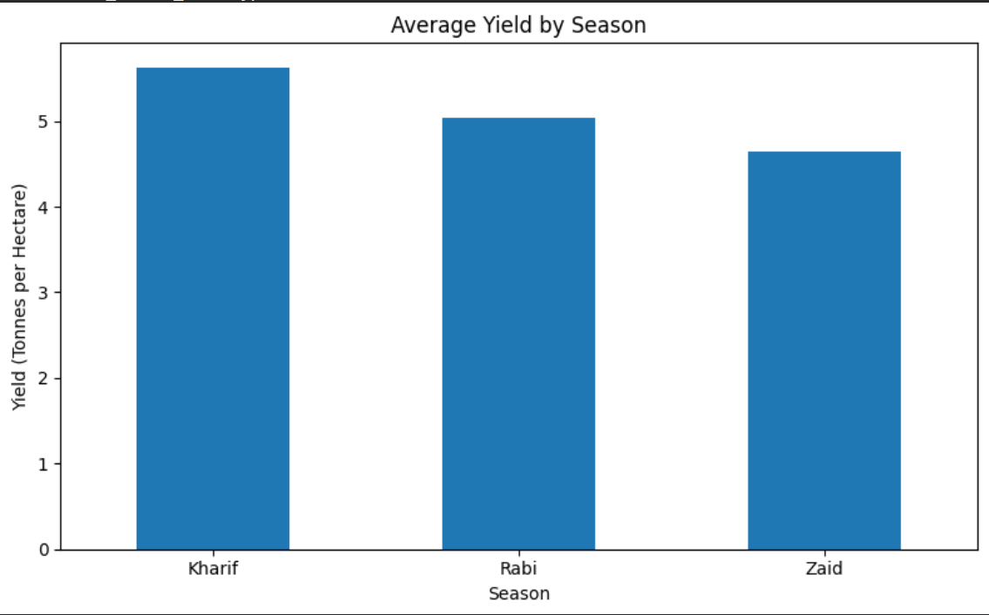
RESULTS :
RESULT 1 – Average Yield by Season
Analysis:
Compared average crop yield across seasons.
Identified seasonal variations in productivity.
Insight:
Shows which seasons have higher or lower crop yield.

Slide 7
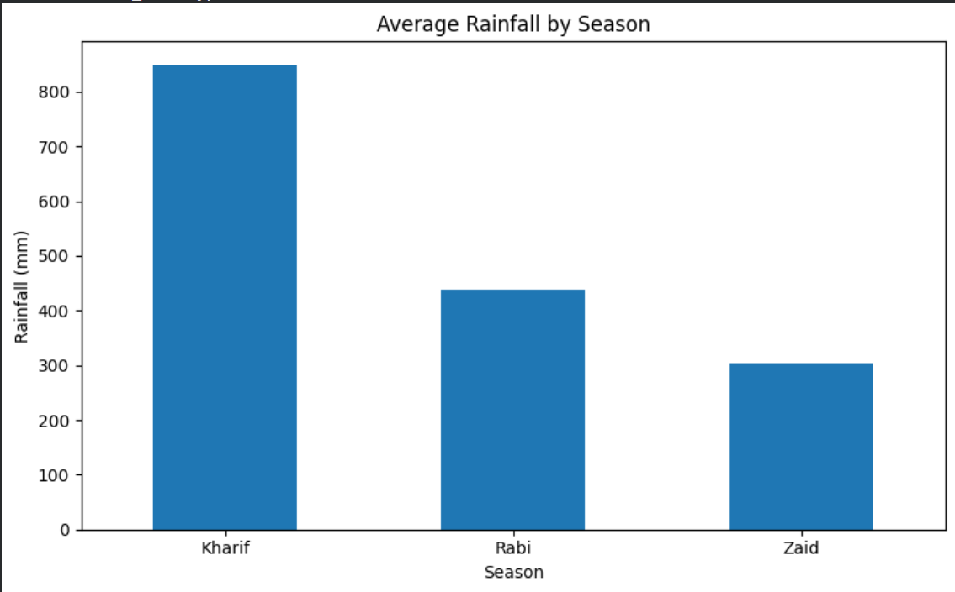
RESULTS :
RESULT 2 – Average Rainfall by Season
Analysis:
Compared average rainfall across different seasons.
Identified seasonal environmental variations.
Insight:
Rainfall patterns may influence crop growth and yield.

Slide 8
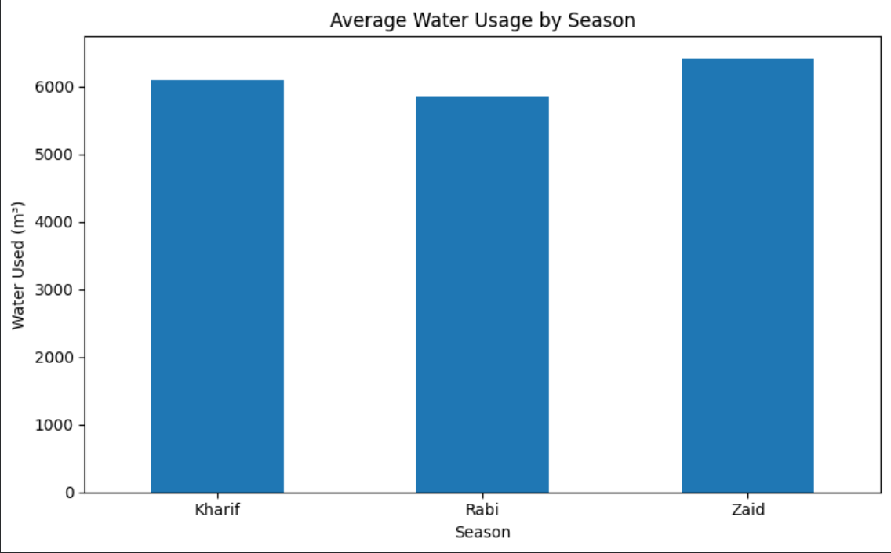
RESULTS
RESULT 3 – Average Water Usage by Season
Analysis:
Compared water usage across seasons.
Identified changes in resource requirements.
Insight:
Helps understand seasonal irrigation needs.

Slide 9
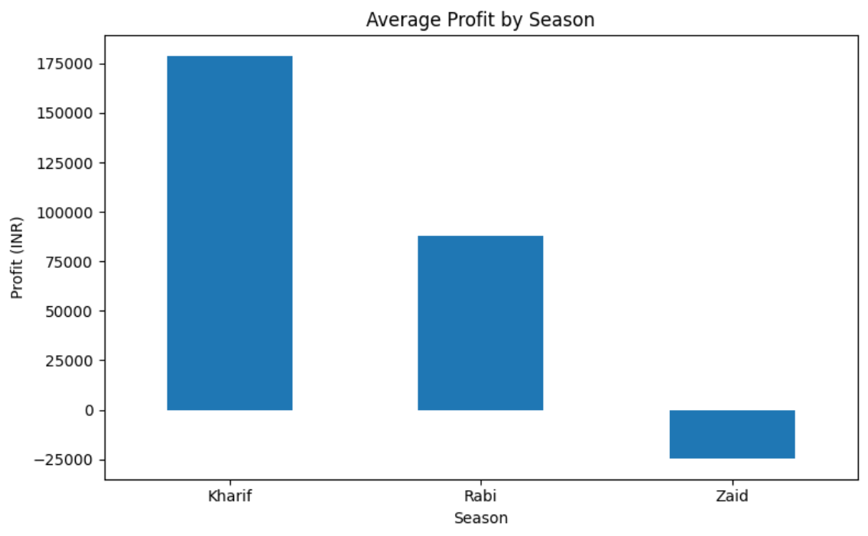
RESULTS
RESULT 4 – Average Profit by Season
Analysis:
Compared average agricultural profit across seasons.
Identified seasonal economic variations.
Insight:
Shows differences in seasonal profitability.

Slide 10
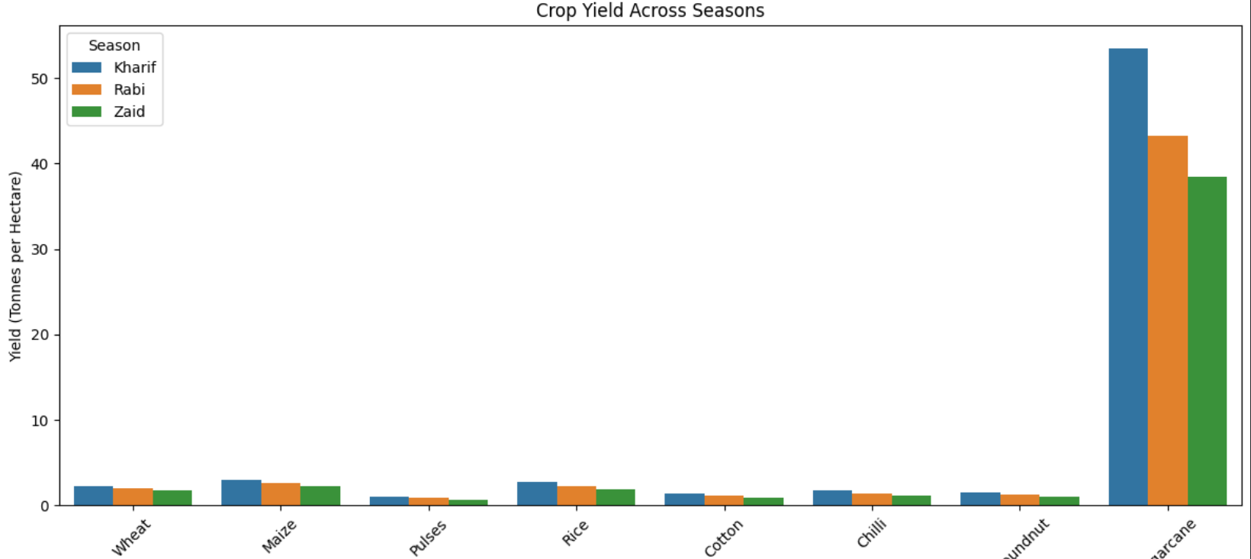
RESULTS
RESULT 5 – Crop Yield Across Seasons
Analysis:
Compared crop yield for different crops and seasons.
Identified variations in crop performance.
Insight:
Different crops may perform differently in each season.

Slide 11
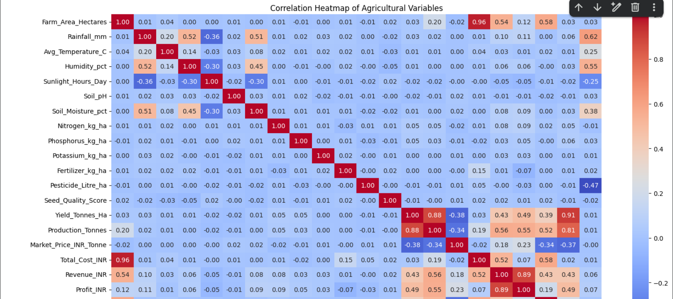
RESULTS
RESULT 6 – Correlation Heatmap
Analysis:
Analyzed relationships between numerical agricultural variables.
Identified positive and negative correlations.
Insight:
Helps understand which factors are related to agricultural performance.

Slide 12
Future scope
The project can be further improved by:
Developing Machine Learning models for crop yield prediction.
Integrating real-time weather data.
Using IoT sensors for soil and environmental monitoring.
Developing smart irrigation recommendations.
Creating crop recommendation systems.
Building an interactive dashboard using Power BI or Streamlit.
Supporting better seasonal agricultural planning using predictive analytics.

Slide 13
GitHub Link
https://github.com/AswiniKumar55/-Seasonal-Agriculture-Performance-Analysis-.git

Slide 14
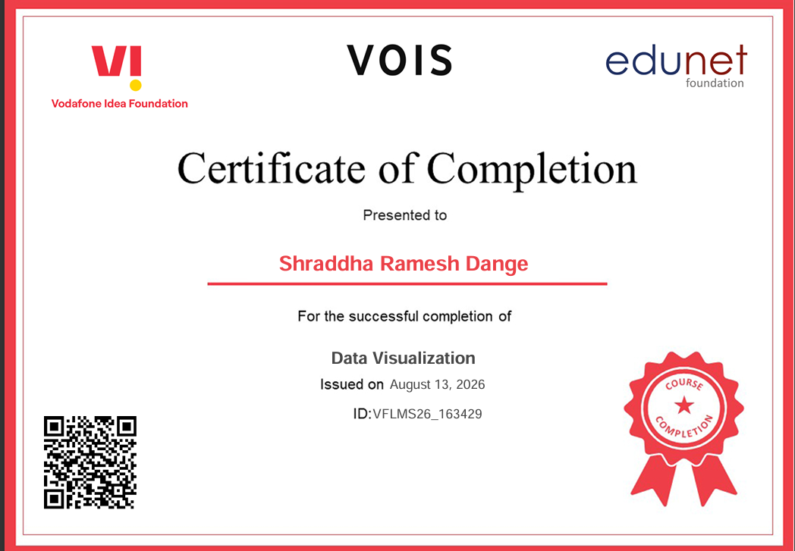
VOIS Course completion certificate - Course name- Data Visualization

Slide 15
Thank you
.
.

